Slide 1
Simulating Realistic Dwarf Galaxy Formation with Fully Hydrodynamical Simulations and Alternate Theories of Dark Matter
Alex Fitts
Michael Boylan–Kolchin
Milos milosavljevic
James Bullock
Volker Bromm
Steven Finkelstein
UT Dissertation talk 8/15/2018

Slide 2
What is ΛCDM?
Majority of matter in the Universe is cold dark matter
Structure in the Universe is formed hierarchically
Notes:
‘Cold’ in the sense that it moved slowly in the early universe compared to the speed of light and ’dark’ in the sense that it only interacts gravitationally and does not interact with light.
In the cold dark matter cosmology, structure grows hierarchically, with small objects collapsing under their self-gravity first and merging in a continuous hierarchy to form larger and more massive objects.

Slide 3
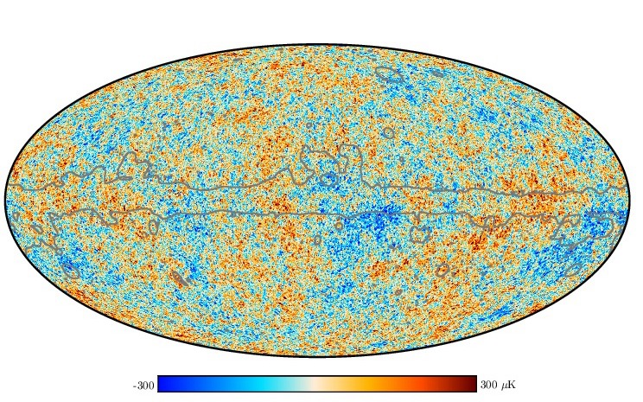
What is ΛCDM?
Majority of matter in the Universe is cold dark matter
Structure in the Universe is formed hierarchically
Dark Matter Halos
Primordial Density Fluctuations
in Early Universe
Notes:
‘Cold’ in the sense that it moved slowly in the universe compared to the speed of light and ’dark’ in the sense that it only interacts gravitationally and does not interact with light.
In the cold dark matter cosmology, structure grows hierarchically, with small objects collapsing under their self-gravity first and merging in a continuous hierarchy to form larger and more massive objects.

Slide 4
What is ΛCDM?
Majority of matter in the Universe is cold dark matter
Structure in the Universe is formed hierarchically
Galaxies
Primordial Density Fluctuations
in Early Universe
Notes:
‘Cold’ in the sense that it moved slowly in the universe compared to the speed of light and ’dark’ in the sense that it only interacts gravitationally and does not interact with light.
In the cold dark matter cosmology, structure grows hierarchically, with small objects collapsing under their self-gravity first and merging in a continuous hierarchy to form larger and more massive objects.

Slide 5
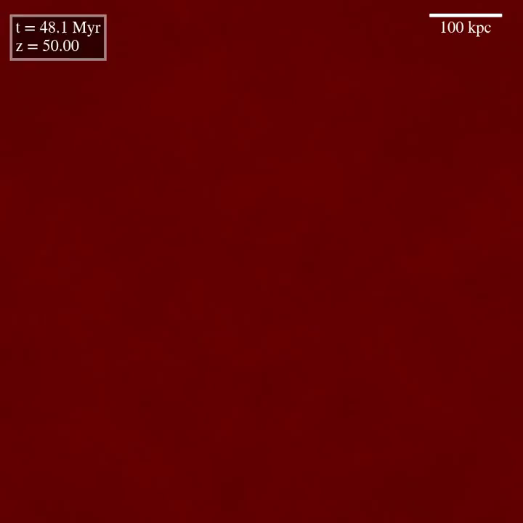
Doug Rennehan, University of Victoria

Slide 6
Small scale issues
Missing Satellites
Core/cusp
Too-Big-to-Fail (TBTF)

Slide 7
Small scale issues
Missing Satellites
Core/cusp
Too-Big-to-Fail (TBTF)

Slide 8
Missing satellites
Bullock & Boylan-Kolchin 2017

Slide 9
Missing satellites
Bullock & Boylan-Kolchin 2017
Notes:
Expect thousands of subhalos that are large enough to support molecular cooling (Mpeak>1e7 Msun) but only find roughly ~50 satellite galaxies down to 300 Msun

Slide 10
Small scale issues
Missing Satellites
Core/cusp
Too-Big-to-Fail (TBTF)

Slide 11
NFW profile universal in ΛCDM simulations
𝛂~-1
ΛCDM Simulations = Cusp for all halo masses
𝛂~0
Observed Dwarfs
= Core
Notes:
This NFW profile is called a cusp as it has a steep negative slope at its very center.

Slide 12
Small scale issues
Missing Satellites
Core/cusp
Too-Big-to-Fail (TBTF)

Slide 13
Densest subhalos have no observational equivalent around the milky way
Garrison-Kimmel et al. 2014
Notes:
ELVIS DMO simulations of Milky Way–sized host halos.
Initially found in MW satellite pop. but has since been found in Andromeda’s Satellites and the field dwarf galaxies.

Slide 14
Small scale issues
Missing Satellites
Core/cusp
Too-Big-to-Fail (TBTF)

Slide 15
Small scale issues
Too many subhalos
Core/cusp
Too-Big-to-Fail (TBTF)

Slide 16
Small scale issues
Too many subhalos
The centers of these subhalos don’t match observation
Too-Big-to-Fail (TBTF)

Slide 17
Small scale issues
Too many subhalos
The centers of these subhalos don’t match observation
The most massive subhalos are too dense to match observation

Slide 18
How can we alleviate these conflicts between simulation and observation?
Notes:
Well there has been encouraging work that has begun to suggest that including baryons into simulations may address all of these issues.
Simulations have previously included dark matter only and have lacked the presence of baryons like gas and stars. Now this is particularly important as Bayonic processes are thought to have a significant impact on these small scales.

Slide 19
baryons helps to address missing satellites
Wetzel et al. 2016
Notes:
Recent simulations of MW-mass halos that included baryons have produced a similar amount of luminous satellites as the MW. I’ve put up here the cumulative stellar mass function of one of these MW-mass with baryons simulations,the Latte simulation, alongside the MW + Andromeda. This is understood to be a combination of tidal forces of the disk potential depleting the number of subhalos around the MW, the inefficiency of galaxy formation at the low mass end as well as the UV background preventing gas from cooling on the smaller halos. Overall this result is encouraging, so lets turn to how baryons affect the very centers of dark matter halos to address the two other issues, CC + TBTF.
are more related to the effects baryonic feedback have on the very centers of dark matter halos and hence provide a more definite test as to whether the inclusion of baryons is enough to address the small scale issues of LCDM.

Slide 20
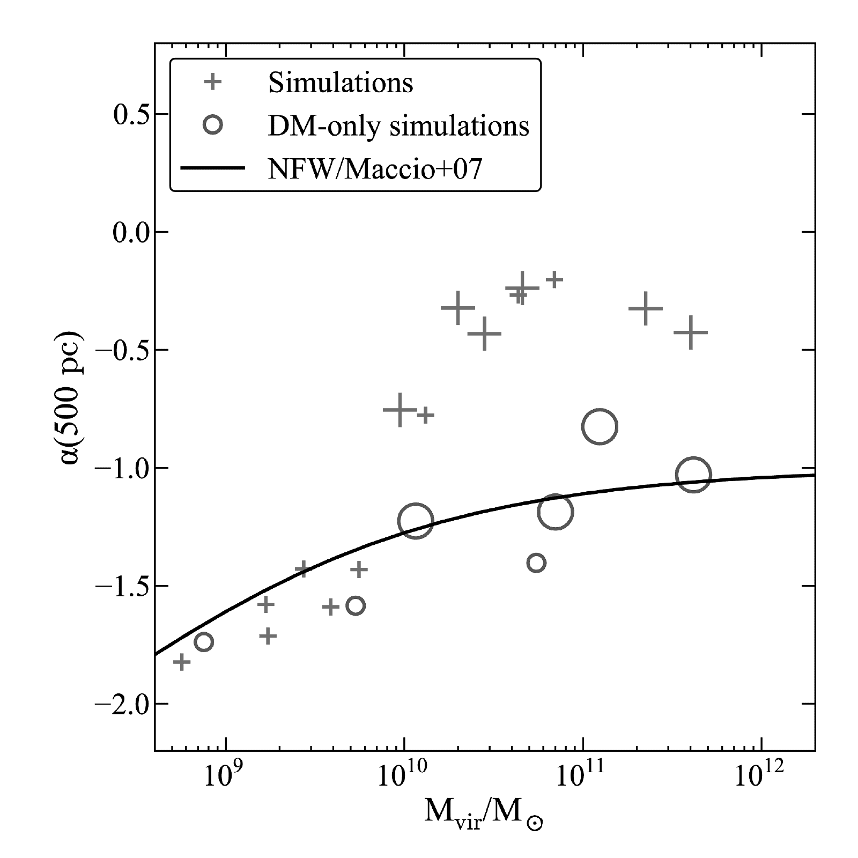
Baryons can also produce cored density profiles
Baryon simulations
Cores
Cusps
Governato et al. 2012

Slide 21
Initially we start with a cuspy profile
Dark Matter Halo
DMO: 𝛂~-1
Hydro: 𝛂~-1
Galaxy

Slide 22
Bursty star formation blows out baryons…
DMO: 𝛂~-1
Hydro: 𝛂~-0.6

Slide 23
…And pulls dark matter with it
DMO: 𝛂~-1
Hydro: 𝛂~-0.2

Slide 24
Repeat this enough times and you get a cored profile!
DMO: 𝛂~-1
Hydro: 𝛂~0

Slide 25
Baryons can produce cored density profiles
Baryon simulations
Cores
Cusps
Governato et al. 2012

Slide 26
M_{vir} ~ 10¹⁰ M = Key mass scale
Baryon simulations
Cusps
w/Baryons
Cores
w/ Baryons
Governato et al. 2012
Notes:
Threshold where baryons switch from being efficient to inefficient at redistributing dark matter in the centers of these galaxies.

Slide 27
M_{vir} ~ 10¹⁰ M = Key mass scale
M_{halo}~10¹⁰ M
Garrison-Kimmel et al. 2014
Notes:
ELVIS DMO simulations of Milky Way–sized host halos.
Initially found in MW satellite pop. but has since been found in Andromeda’s Satellites and the field dwarf galaxies.

Slide 28
Why this scale requires a closer look
Previous simulations are spread across a range of masses and run at lower resolutions
Predicted properties from simulations at this mass scale are inconsistent
Best scale to study whether baryons can address small scale issues within ΛCDM
Notes:
Important threshold to understand what drives core formation in halos
Perfect range to test whether baryonic physics can alleviate the TBTF problem
It’s important to tell whether or not baryons can address these small scale issues as its one of the last solutions we have on the theoretical side without starting to tweak LCDM itself. It’s also important to nail down the predicted galaxy properties associated with core formation so that we can look for these markers in observation to confirm our findings.
This is also a great place to focus on low-mass galaxy formation. Dwarf galaxies are at the edge so where galaxies even form in dark matter halos so it is interesting to explore how halo assembly, which is already well understood in the LCDM framework, compares to actual galaxy assembly for low mass dwarfs.

Slide 29
Fire in the field Simulation suite
15 ‘field’ dark matter halos at M_{vir}~10¹⁰ M
Cosmological: selected from 35³ Mpc³ boxes
Force resolution: ε_{gas}~ 2 pc, ε_{dm}~35 pc
Mass resolution: M_{gas}~ 500 M, M_{dm}~ 2500 M
Notes:
I call them field dark matter halos in that they are selected to be outside the virial radii of any larger halos, making them equivalent to field dwarf galaxies in the Local Volume. This is so we can focus on the impact baryons have on these dwarfs without having to worry about any environmental influence on the results.
These are zoom-in cosmological simulations, so each dwarf is simulated with dark matter only at low resolution in a cosmological volume 35 Mpc on each, while only the region around each dwarf galaxy is simulated at high resolution and with baryons. This allows us to achieve unparalleled level of resolution in our dwarfs while also ensuring they form in the proper large-scale environment. Here I’ve got the force resolution and mass resolutions scales for the baryons and dm in my dwarf simulations. These are some of the most highly resolved simulations of dwarf galaxies to date, and show the level of resolution required to properly resolve the baryonic feedback schemes in our simulations.

Slide 30
Fire in the field Simulation suite
15 ‘field’ dark matter halos at M_{vir}~10¹⁰ M
Cosmological: selected from 35³ Mpc³ boxes
Force resolution: ε_{gas}~ 2 pc, ε_{dm}~35 pc
Mass resolution: M_{gas}~ 500 M, M_{dm}~ 2500 M
GIZMO hydro code in MFM mode (Hopkins 2015)
FIRE-2 feedback (Hopkins et al. 2018)
Stellar Feedback
Stellar Formation
Gas Cooling
Reionization
Notes:
I call them field dark matter halos in that they are selected to be outside the virial radii of any larger halos, making them equivalent to field dwarf galaxies in the Local Volume. This is so we can focus on the impact baryons have on these dwarfs and not have to worry about any environmental influence on the results.
These are zoom-in cosmological simulations, so each dwarf is simulated in a cosmological volume 35 Mpc on each side that is at low resolution with dark matter only, while only the region around the dwarf galaxy is simulated at high resolution with baryons. This allows us to achieve unparalleled level of resolution in our dwarfs while also ensuring they form in the proper large-scale environment. Here I’ve got the force resolution and mass resolutions scales for the baryons and dm in my dwarf simulations. These are some of the most highly resolved simulations of dwarf galaxies to date, and show the level of resolution required to properly resolve the baryonic feedback schemes in our simulations.

Slide 31
Mass assembly Histories
Fitts et al. 2017
Notes:
I want to first take a look at how my dwarfs have been assembled, as not only will this be important later for addressing the small scale issues of LCDM, it is interesting in its own right. We know quite well how dark matter halos are assembled from DMO simulations but it is an open question how galaxy formation proceeds, especially at the low mass end.
Black dashed line is the mean mass assembly history for all the halos at this mass range in the Millennium II simulations.
Assembly history spread not m vir spread

Slide 32
Mass assembly Histories
Simulations
Mean Assembly History
(Fakhouri 2010)
Fitts et al. 2017
Notes:
Black dashed line is the mean mass assembly history for all the halos at this mass range in the Millennium II simulations.
Assembly history spread not m vir spread

Slide 33
A glance at M★
Notes:
Look at the spread of Mstar with such a narrow range of Mvir.

Slide 34
A glance at M★
Note narrow range of halo masses
Notes:
Look at the spread of Mstar with such a narrow range of Mvir.

Slide 35
Simulated Star Formation Histories
Observed Star Formation Histories
Fitts et al. (2017)
Notes:
So we now see that the dm mass assembly history is what we would expect from a 10^10 mass halo and here we see that we are producing stellar mass assembly histories that we would expect for field dwarf galaxies of this size.

Slide 36
early mass assembly correlates with M★(z=0)
Fitts et al. 2017
Notes:
Strong correlation between early DM assembly and stellar mass at z=0.

Slide 37
early mass assembly correlates with M★(z=0)
m10a
No stars
Fitts et al. 2017

Slide 38
V_{max} is a measure of central density
Fitts et al. (2017)

Slide 39
V_{max} correlates with M★(z=0) as well
Increasing
Stellar Mass
Fitts et al. (2017)
Notes:
So Now I just want to look at how this increased stellar mass

Slide 40
Star formation rate
Fitts et al. (2017)
Notes:
Galaxies with higher stellar mass at z=0 have higher star formation rates which in turn drive larger gravitational potential fluctuations.

Slide 41
Radial density profiles
r_{1/2}
Fitts et al. (2017)

Slide 42
Radial density profiles
Increasing M★
Reduction in Central Density
Notes:
CHANGE BLACK ARROWS
Reduction in Central Density

Slide 43
Radial density profiles
All galaxies have same halo mass of ~10¹⁰ M
No cores for halos with M★< ~2×10⁶ M (Governato et al. 2012, Di Cintio et al. 2014, Dutton et al. 2016)

Slide 44
Central density Reduction
Increasing M★
Fitts et al. (2017)
Notes:
Draw arrow as build increasing stellar mass, decreasing central density another arrow showing this sets in at half light radius

Slide 45
r_{1/2} marks extent of reduction
Increasing M★
Fitts et al. (2017)
Notes:
Draw arrow as build increasing stellar mass, decreasing central density another arrow showing this sets in at half light radius

Slide 46
Central density reduction vs stellar mass
Fitts et al. (2017)

Slide 47
DMO central density + Stellar mass
Fitts et al. (2017)

Slide 48
DMO central density + Stellar mass
Fitts et al. (2017)

Slide 49
Stellar mass vs dmo central density
Fitts et al. (2017)

Slide 50
Central density Recap
Early dark matter mass → present-day stellar mass
higher concentration, higher V_{max} halos build up more stellar mass earlier
M★(z=0) correlates well with density reduction
No modification from dark-matter-only simulations below M★~10⁶ M, density reduction and dark matter cores at higher stellar masses
Central density in the dark-matter-only version of each halo → present-day stellar mass.
Central density in DMO simulations may serve as a "second parameter" in setting stellar masses at fixed dark matter halo mass.
Notes:
This looks great! These are believable looking dwarfs, modeled with all the physics above the GMC level. But the story is not so clear….

Slide 51
But Does the inclusion of baryons sufficiently address TBTF?

Slide 52
field dwarfs still present a problem
Bullock & Boylan-Kolchin 2017
Notes:
Now admittedly, there are a number of assumptions that go into deriving velocities from HI linewidths and as recent papers have shown, the current models aren’t 100% accurate . That being said, this is evidence that baryons may not be able to answer all of our problems at the small scale end and it might be worth looking beyond our standard theory of cold dark matter.

Slide 53
Looking beyond the standard ΛCDM cosmology
Warm Dark Matter
Self-interacting Dark Matter
Notes:
How do alt. theories of DM affect galaxy formation in dwarfs?
How well does WDM with hydrodynamics address the small scale issues of CDM?
Two viable alterative theories of dark matter that can naturally lower the central density of halos without baryons. So it’s worth investigating how the addition of baryons affects the central densities in these alternate dark matter theories and whether it can further lower the central densities beyond what I capable in LCDM with baryons.
WDM decouples while relativistic imparting the particles with a significant late-time velocity that opposes gravitational collapse on galaxy scales thus assembling dark matter halos differently than CDM

Slide 54
Alternate theories of Dark Matter
Warm Dark Matter
Self-interacting Dark Matter
Notes:
Warm dark matter particle species have larger intrinsic rms velocity than CDM particle candidates which are cosmologically important. The WDM model’s cosmologically-significant velocity distribution introduces a free-streaming scale below which primordial density perturbations of the early Universe are wiped out.

Slide 55
Truncation of power spectrum
Bullock & Boylan-Kolchin 2017
Notes:
The free-streaming effects of the models we consider are well described by the small-scale truncation in the linear matter power spectrum. In WDM this scale is relevant for galaxy formation, for example a 2keV thermal WDM particle will reduce power for linear scales corresponding to linear mass scales of 10^9, which is relevant for galaxy formation.

Slide 56
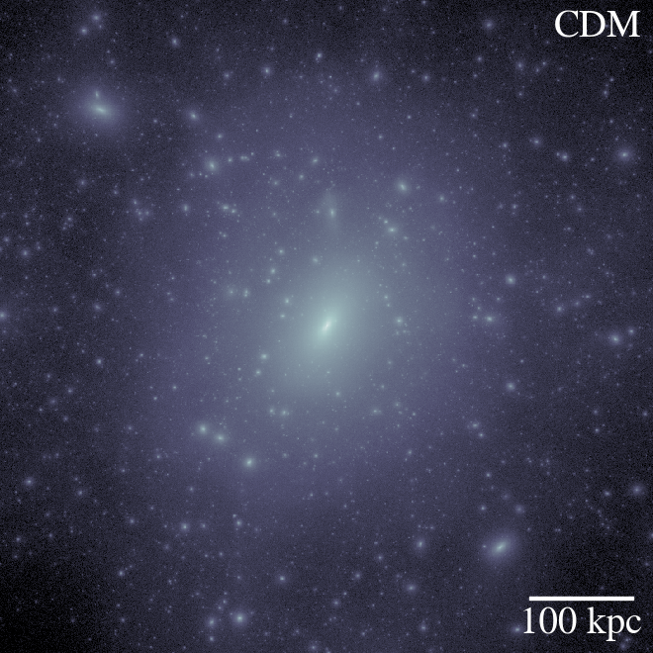
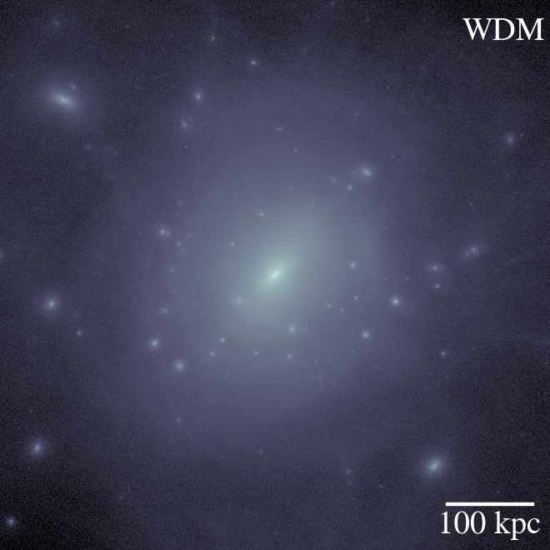
Equals less substructure
Bullock & Boylan-Kolchin 2017
Notes:
However, the effects of power spectrum suppression are not limited to the pure number counts of DM halos. The erasure of small perturbations in WDM models results in a different assembly history for low-mass halos than for CDM.

Slide 57
Alternate theories of Dark Matter
Warm Dark Matter
We consider a resonantly produced sterile neutrino with an effective thermal mass of 2 keV
Self-interacting Dark Matter
Notes:
This model was selected to (1) provide free-streaming effects that at the edge (i.e., the warmest) of what is allowed based on satellite galaxy counts and large-scale structure constraints of the Lyman-$\alpha$ forest and (2) account for the origin of possible detections of an X-ray line at 3.55 keV in galaxy and galaxy cluster observations

Slide 58
WDM halos have later formation times
Bozek, Fitts et al. (2018)
Notes:
Still have very similar virial masses! M10b is now dark!
WDM halos/galaxies form later -> lower central densities than CDM
Lower central densities -> less stellar feedback than CDM
Less stellar feedback -> cuspier than CDM
WDM galaxy formation predicts a population of extremely late star formers (don’t contain any ancient star populations).

Slide 59
Later assembly➔ lower stellar mass
Bozek, Fitts et al. (2018)
Notes:
Unique prediction: UFDs with only RECENT star formation.

Slide 60
Dwarf galaxies w/o old stars unique to WDM
Bozek, Fitts et al. (2018)
Notes:
Unique prediction: UFDs with only RECENT star formation.

Slide 61
Comparison to CDM density profiles
Bozek, Fitts et al. (2018)
Notes:
Despite feedback being slightly more efficient in CDM, the free-streaming effects of WDM still reduce the central densities in our dwarfs relative to their CDM counterparts.

Slide 62
Alternate theories of Dark Matter
Warm Dark Matter
Self-interacting Dark Matter

Slide 63
Self-interaction leads to isothermal cores
Elbert et al. (2015)

Slide 64
Alternate theories of Dark Matter
Warm Dark Matter
Self-interacting Dark Matter
Implementation of Rocha et al. (2013)
𝝈/m ~ 1 g/cm²

Slide 66
No Effect on
Assembly History!

Slide 67
SIDM uniformly lowers central density

Slide 68
How can we distinguish these theories from one another?

Slide 69
Disentangling dark matter theories
‘Ultra-faint Dwarf'
M★<10⁶ M⦿
‘Classic Satellite’ M★~10⁷ M⦿

Slide 70
Disentangling dark matter theories
‘Ultra-faint Dwarf'
M★<10⁶ M⦿
‘Classic Satellite’ M★~10⁷ M⦿
Self-interaction ➞
UFDs w/ cores

Slide 71
Rotation velocities in the field

Slide 72
Rotation velocities in the field
Small + Faint
UFDs
Large + Bright
Classic Sat.

Slide 73
Evidence of SIDM?
Small + Faint
UFDs
Large + Bright
Classic Sat.

Slide 74
V_{1/2}-R_{1/2} relation

Slide 75
Larger halo mass can’t explain difference
CDM, M_{vir}~10¹⁰-10¹¹
Graus et al. (in prep.)

Slide 76
Smaller halo mass helps but still not 100% clear
Analytical coreNFW fits from Read et al. (2016)

Slide 77
Alternate DM theories Recap
CDM➞WDM
Results in later assembly, reduced stellar mass
Generally lowers density, though not uniformly
Unique: UFDs w/ no old stars
Adding self-interaction
Does little to affect assembly history
Uniformly lowers central density
Unique: UFDs w/ cores
Alt. DM may help address observed LF dwarfs with low V_{1/2} at set r_{1/2}

Slide 78
outlook
Simulations
Local Volume (ELVIS on FIRE, Garrison-Kimmel et al. 2018)
Statistical sample of dwarf simulations (Munshi et al. 2017)
Hi-res UFD dwarf simulations
Observations
More complete accounting of local dwarf population (DES, LSST)
Better understanding of velocities derived from HI observation (e.g. Pineda et al 2017, Verbeke et al 2017)

Slide 79
Fin.

Slide 80
Thanks to all those who supported me
Notes:
It’s been a wild ride, and I’m so happy to have shared the experience with all of you.

Slide 81
extras

Slide 83
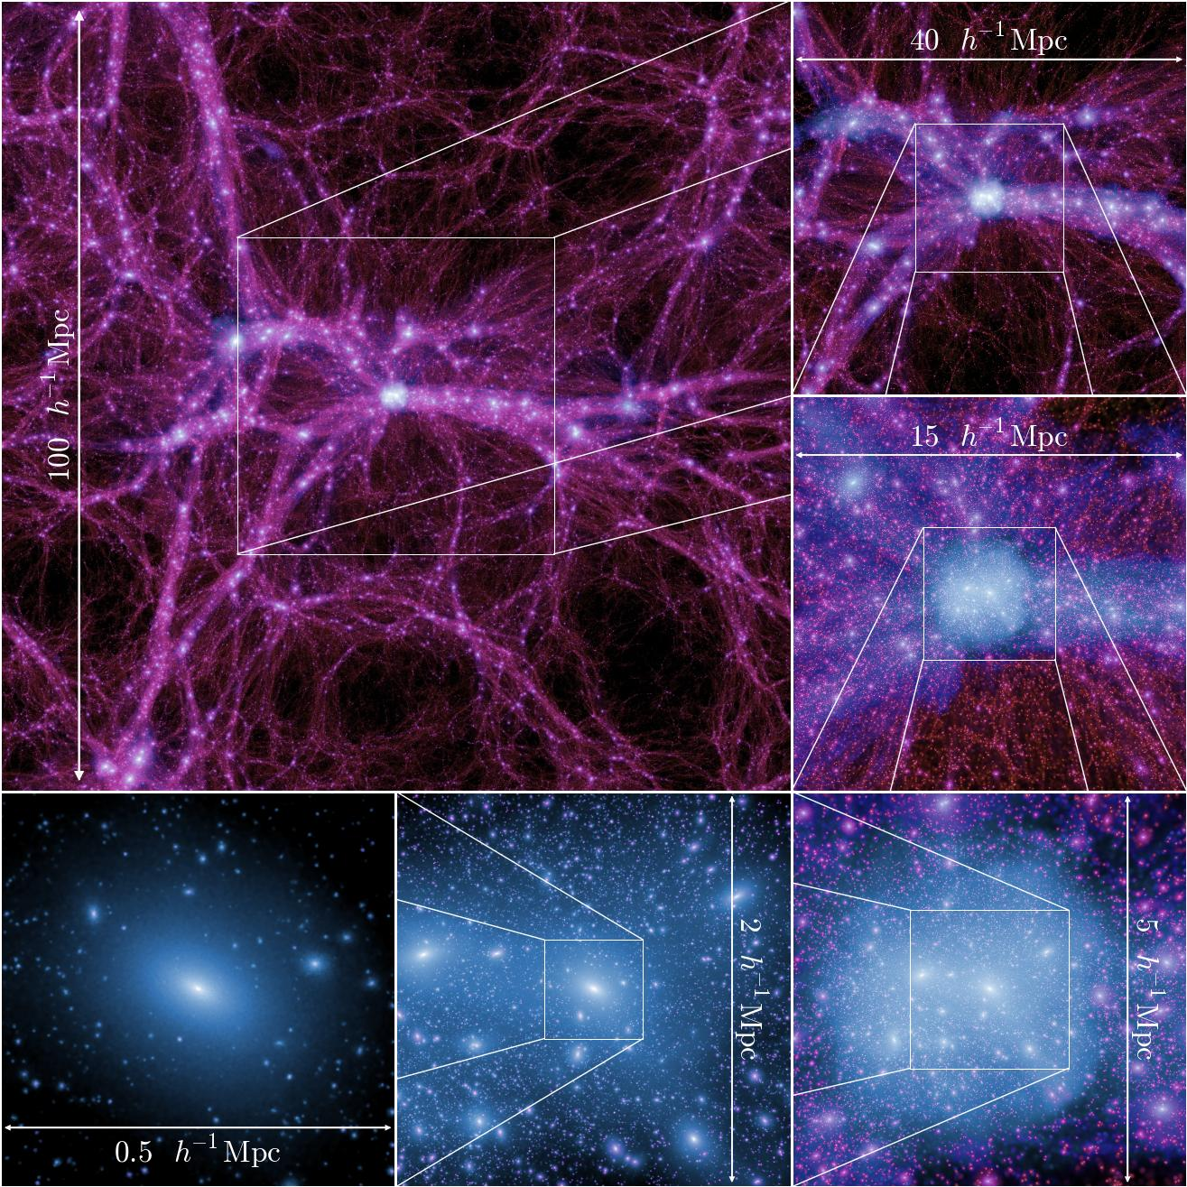
Boylan-Kolchin et al. 2009
Notes:
Precise determinations of the mass function of halos throughout redshift.
----- Meeting Notes (4/25/16 01:06) -----
In the standard cold dark matter (CDM) paradigm, the formation of galaxies is driven by the large-scale structure of the universe and the formation of dark matter halos. Galaxies form by the cooling and condensation of gas in the centers of the potential wells of extended virialized dark matter halos. in this picture, galaxy properties, such as luminosity or stellar mass, are expected to be tightly coupled to the depth of the halo potential and thus to the mass.

Slide 84
Temperature anisotropy of CMB
Planck et al. 2018

Slide 85
ΛCDM reproduces cmb anisotropies
Planck et al. 2018

Slide 86
Boylan-Kolchin et al. 2009
Notes:
Precise determinations of the mass function of halos throughout redshift.
----- Meeting Notes (4/25/16 01:06) -----
In the standard cold dark matter (CDM) paradigm, the formation of galaxies is driven by the large-scale structure of the universe and the formation of dark matter halos. Galaxies form by the cooling and condensation of gas in the centers of the potential wells of extended virialized dark matter halos. in this picture, galaxy properties, such as luminosity or stellar mass, are expected to be tightly coupled to the depth of the halo potential and thus to the mass.

Slide 87
NFW profile universal in ΛCDM simulations
NFW (cusp)
𝛒~r ⁻¹
Burkert (core)
𝛒~r ⁰

Slide 88
Cored profiles fit certain observations
Bullock & Boylan-Kolchin 2017
Notes:
----- Meeting Notes (4/25/16 00:43) -----
Rotation curves of LSB and late-type, gas-rich dwarf galax- ies indicate the presence of constant-density or mildy cuspy (α ∼ −0.2) dark matter cores, contradicting the predictions of cosmological simulations. The most recent simulations still indicate resolved mass density slopes that are too steep to be easily reconciled with the observations (typically α ∼ −0.8 at a radius ∼ 0.1 kpc). Claims of shallow slopes at even smaller radii depend on the validity of the analytical description cho- sen for the mass-density profile.

Slide 89
M_{halo} ~ 10¹⁰ M = Key mass scale
Bullock & Boylan-Kolchin 2017

Slide 90
V_{max} through time
Reionization heating
Fitts et al. (2017)
Notes:
Facher-Giguere et al. 2009 for line

Slide 96
Timing of reionization
Elbert et al. (in prep)
Notes:
The transition to dark halos is dependent on the timing of reionization and is rather abrupt!

Slide 97
Timing of reionization
Elbert et al. (in prep)
Notes:
The transition to dark halos is dependent on the timing of reionization and is rather abrupt!

Slide 98
shifts galaxy formation cutoff
Elbert et al. (in prep)
Notes:
The transition to dark halos is dependent on the timing of reionization and is rather abrupt!

Slide 99
Dark halo/ UFD boundary
Notes:
Improved cosmic ray treatment (also tweaking the reionization) can alter the transition mass to dark halo and also the composition of those on the edge! Our sims had mostly in situ formation, but the new sims had m10a which was comprised of a number of UFDs merging! Also there were increased numbers of UFD satellites for these field dwarfs.

Slide 100
Doesn’t seem to affect late-time SF
Elbert et al. (in prep)

Slide 101
Gas shells throughout time

Slide 102
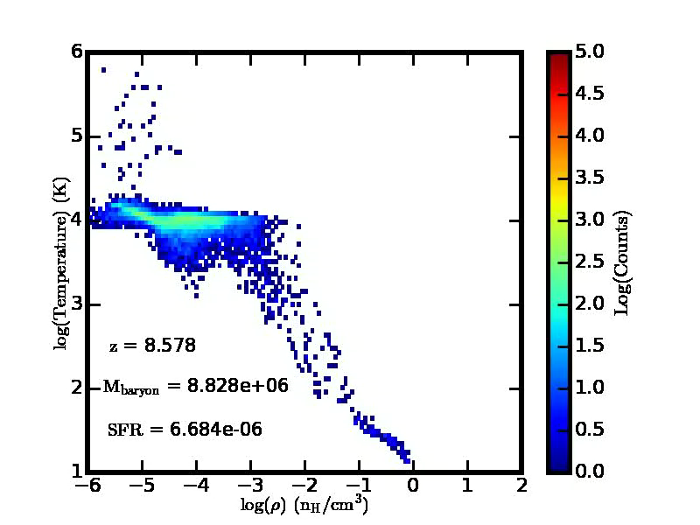

Slide 103
Comparison to observed dwarfs
Fitts et al. 2017

Slide 104
DMO convergence

Slide 105
Hydro convergence

Slide 106
Convergence in rotation curves

Slide 107
Stellar Extent

Slide 108
Cutoff in galaxy formation
Fitts et al. (2018)

Slide 109
Assumption:
Low-mass galaxies form monolithically
Fitts et al. (2017)
Notes:
While we’re here looking at assembly histories for the dark matter and stellar mass, I want to take a brief

Slide 110
Is this true for our simulations?
Assumption:
Low-mass galaxies form monolithically
Fitts et al. (2017)
Notes:
While we’re here looking at assembly histories for the dark matter and stellar mass, I want to take a brief

Slide 111
Mass assembly histories
Fitts et al. (2018)

Slide 112
Average galaxy merger history
Fitts et al. (2018)

Slide 113
In situ formation domination
merger
merger
Fitts et al. (2018)

Slide 114
In situ formation domination
merger
merger
Fitts et al. (2018)

Slide 115
In situ sfh vs accreted SFH
Fitts et al. (2018)
Notes:
Halo m10e

Slide 116
Low-mass galaxy Assembly Recap
Early dark matter mass → present-day stellar mass
Galaxy mergers contribute little to dwarf galaxies
Validates using stellar fossil record to trace SFH of dwarfs
Galaxy mergers occur during the early assembly phase
All stars contributed by galaxy mergers are uniformly ancient

Slide 117
Mass assembly histories
Fitts et al. (2017)
Notes:
Strong correlation between early DM assembly and stellar mass at z=0.

Slide 118
Average halo merger history
Fitts et al. (2018)

Slide 119
Average galaxy merger history
Fitts et al. (2018)

Slide 120
Even less if we focus on visible component
Fitts et al. (2018)

Slide 121
M★-M_{halo} relation at z=0
Garrison-Kimmel et al. 2017a
Notes:
Cyan is low, Magenta is fiducial. Recent observations of M94 argue for a steeper slope and larger scatter (Smercina et al. 2018).

Slide 122
In situ sfh vs accreted SFH
Fitts et al. (2018)
Notes:
Halo m10f

Slide 123
M★-M_{halo} relation throughout time
Fitts et al. (2018)
Notes:
this is very difficult to constrain observationally, making simulations an important guide

Slide 124
M★-M_{halo} relation throughout time
Behroozi et al. (2018)
extrapolated
Fitts et al. (2018)

Slide 125
M★-M_{halo} relation throughout time
Fitts et al. (2018)

Slide 126
Dmo vs hydro predictions
Fitts et al. (2018)
Notes:
So long as the correct Mstar-Mhalo relation is known, DMO simulations match our hydro sims perfectly. Even if the relation isn’t well constrained, the overall behavior of the mergers is the same.

Slide 127
Satellites of dwarfs
Fitts et al. (2018)

Slide 128
Satellites of dwarfs
Increasing resolution
Fitts et al. (2018)

Slide 129
Later formation ➔ lower central halo densities
Bozek, Fitts et al. (2018)

Slide 130
Baryonic feedback in WDM
Bozek, Fitts et al. (2018)
Notes:
Baryonic feedback is more effective at lowering central density in CDM for all but one of our dwarfs.

Slide 132
Rotation curves

Slide 134
4 dwarfs in 5 theories of dm

Slide 135
CDM initially appears to be a good fit
DMO
5/11 unmatched
Hydro
1/11 unmatched

Slide 136
R_{1/2}-M★ relation constant across dm theories

Slide 137
Smaller dwarfs may reside in larger halos

Slide 138
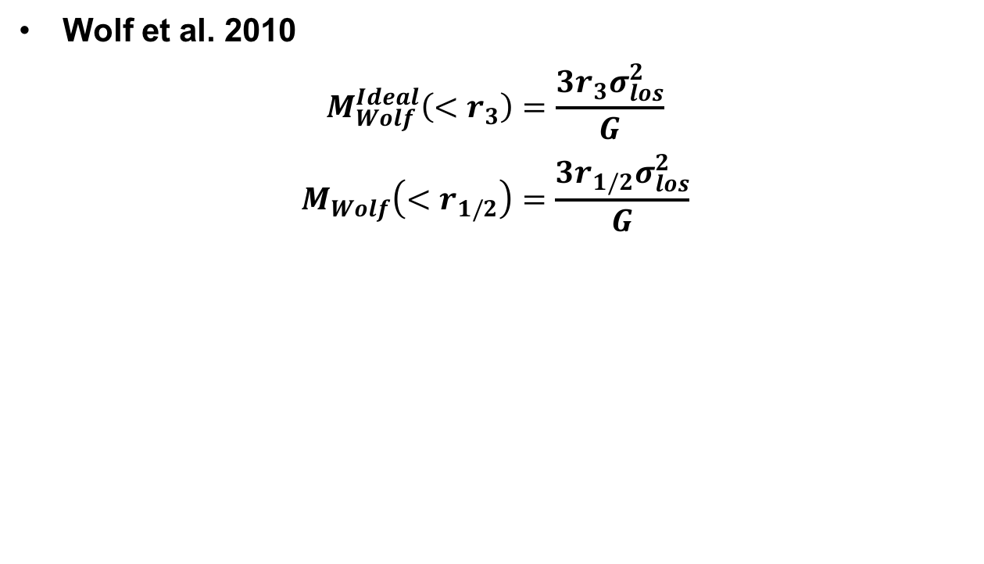
Wolf Estimator
Wolf et al. 2010
$$M_{Wolf}^{Ideal}\left(<r_{3}\right)=\frac{3r_{3}σ_{los}^{2}}{G}$$
$$M_{Wolf}\left(<r_{1/2}\right)=\frac{3r_{1/2}σ_{los}^{2}}{G}$$

Slide 139
Missing satellites
Kravtsov et al. 2010
Notes:
----- Meeting Notes (4/25/16 01:24) -----
Cumulative circular velocity function

Slide 140
Penarrubia et al. 2012
Notes:
----- Meeting Notes (4/24/16 23:11) -----
Red shaded region = energy to form a core
Black dots = 1kpc
Right axis is luminosity derived from a star formation efficiency tuned to reproduce the number of luminous satellites in our Galaxy. SNeII energy.

Slide 141
Somerville 2015
Notes:
----- Meeting Notes (4/25/16 10:02) -----
Dwarfs are interesting because they have shallow potential wells and are therefore sensitive to both stellar feedback and UV background feedback
10^10 M_sun is about the halo mass of a typical dwarf with stellar mass of 1e6 in current models.

